Slide 1
Software Engineering
Lesson topic – Design Patterns

Slide 2
Lesson Content
What are design patterns
Strengths and problems with design patterns
3 types of design patterns
Examples of design patterns
Singleton
Factory (and Abstract Factory)
Strategy
Decorator
Composite
Facade

Slide 3
Structural Patterns
Deal with the larger composition of classes /objects

Slide 4
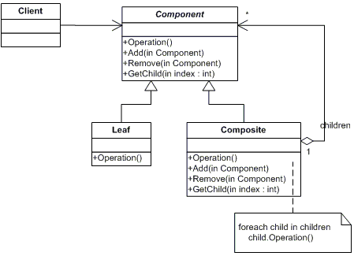
Composite Pattern

Slide 5
Composite Pattern
Composite Pattern are ideal when a group of objects needs to be treated as one single object.
When dealing with collections of objects, there are often operations that are appropriate for both a single object and the entire collection
Composite Patterns treat objects in term of a tree structure to represent part as well as whole hierarchy.

Slide 6
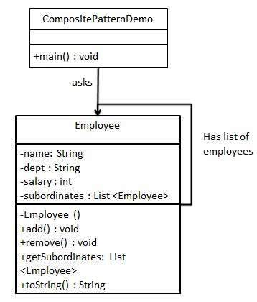
Composite Pattern
This pattern creates a class that contains a collection of its own objects.
This class provides ways to modify its group of same objects

Slide 7
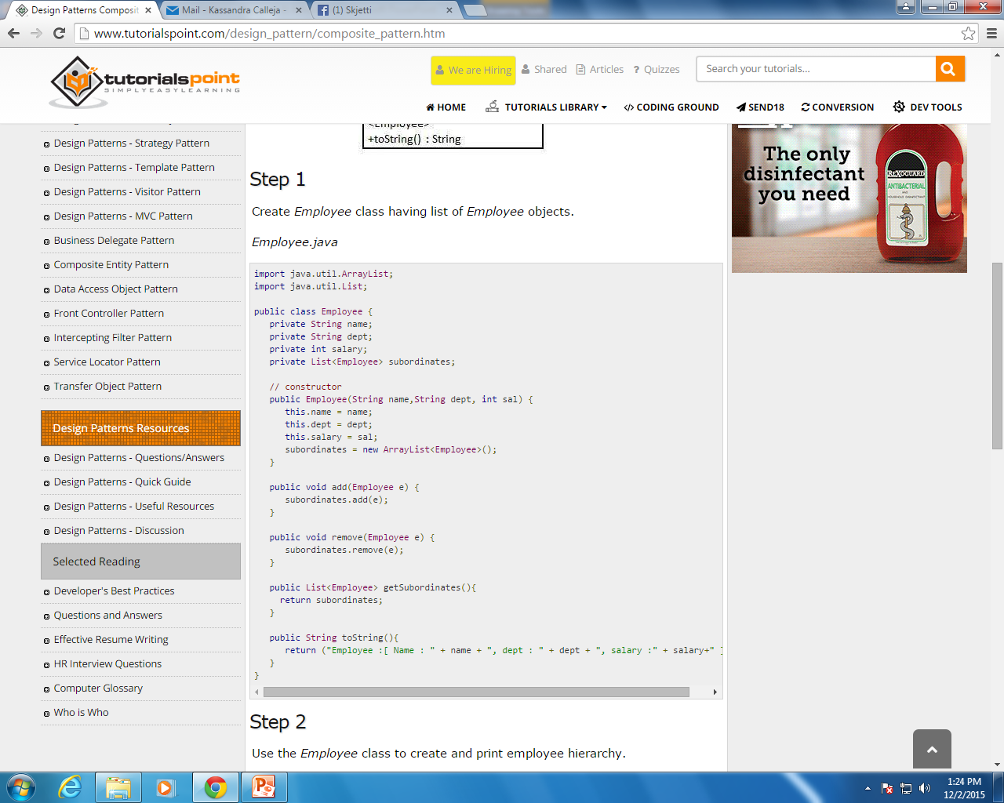
Composite Pattern

Slide 8
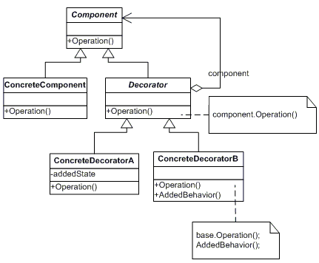
Decorator Pattern

Slide 9
Decorator Pattern
Decorator pattern allows a user to add new functionality to an existing object without altering its structure.
It attaches additional responsibilities to an object dynamically.
This pattern creates a decorator class which wraps the original class and provides additional functionality keeping class methods signature intact.
It is Flexible alternative to sub-classing for extending functionality

Slide 10
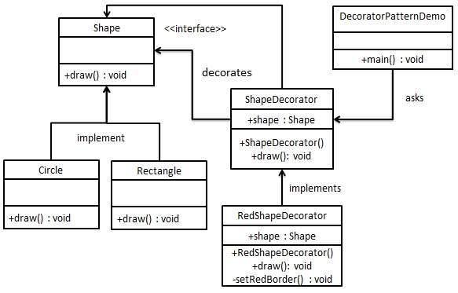
Decorator Pattern UML Class Diagram

Slide 11
Decorator Pattern UML Class Diagram
The structure has a Shape interface and concrete classes implementing the Shape interface.
The abstract decorator classShapeDecorator implements the Shape interface with Shape object as its instance variable.
RedShapeDecorator is concrete class implementing
ShapeDecorator.
DecoratorPatternDemo, use RedShapeDecorator to decorate Shape objects.

Slide 12
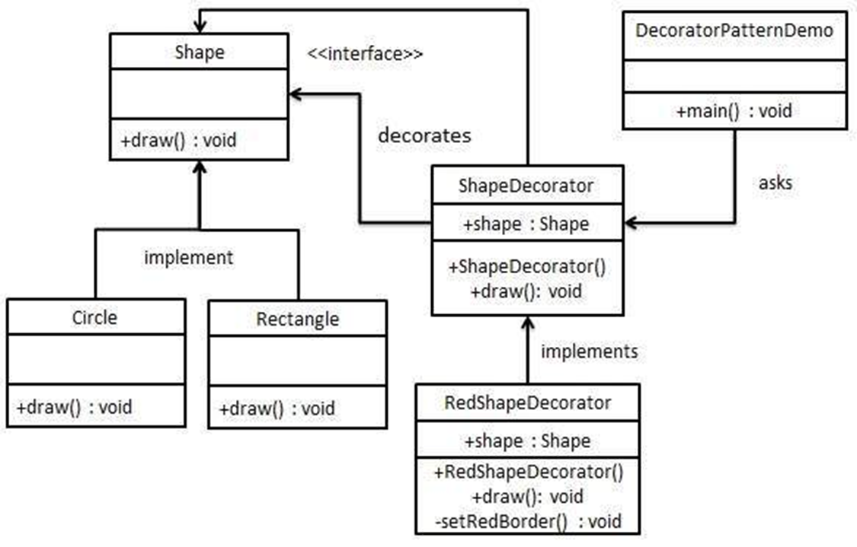
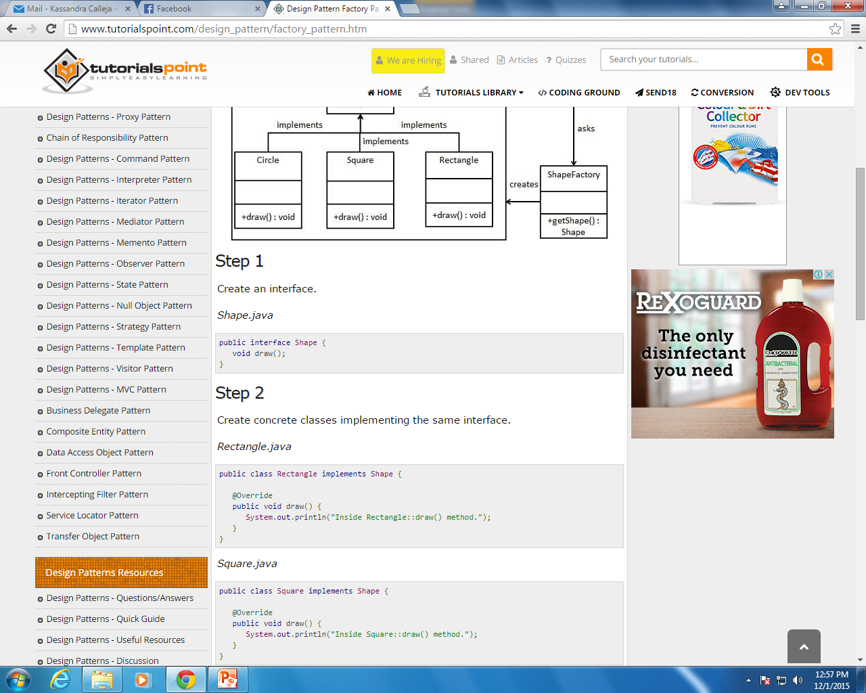

Decorator Pattern UML Class Diagram
Step 1
Create the interface Shape
Step 2
Create concrete classes implementing the same interface.

Slide 13
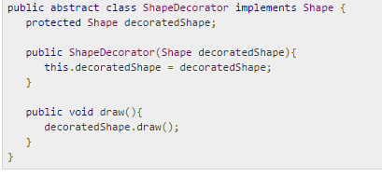

Decorator Pattern UML Class Diagram
Step 3
Create abstract decorator class implementing the Shape interface.

Slide 14
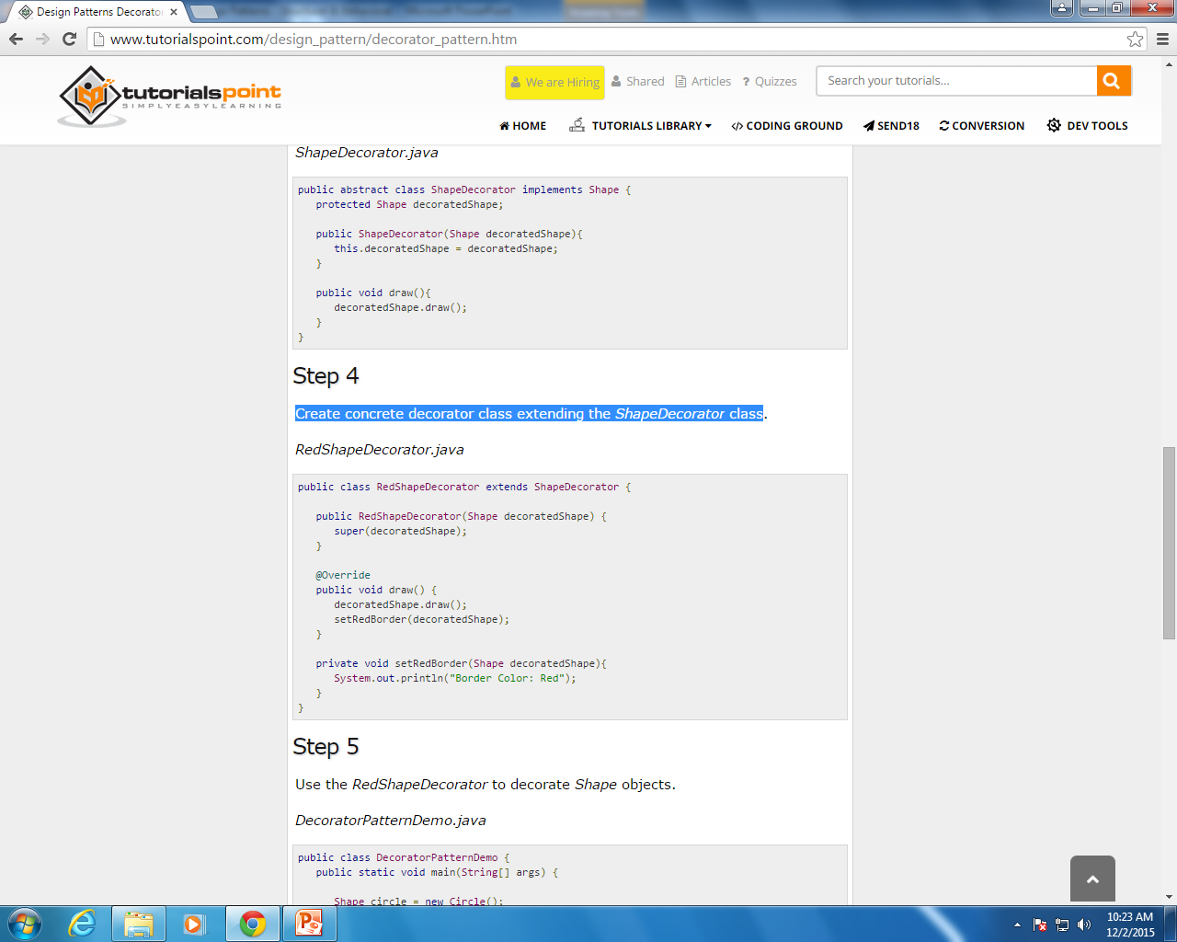
Decorator Pattern UML Class Diagram
Step 4
Create concrete decorator class extending the ShapeDecorator class.

Slide 15
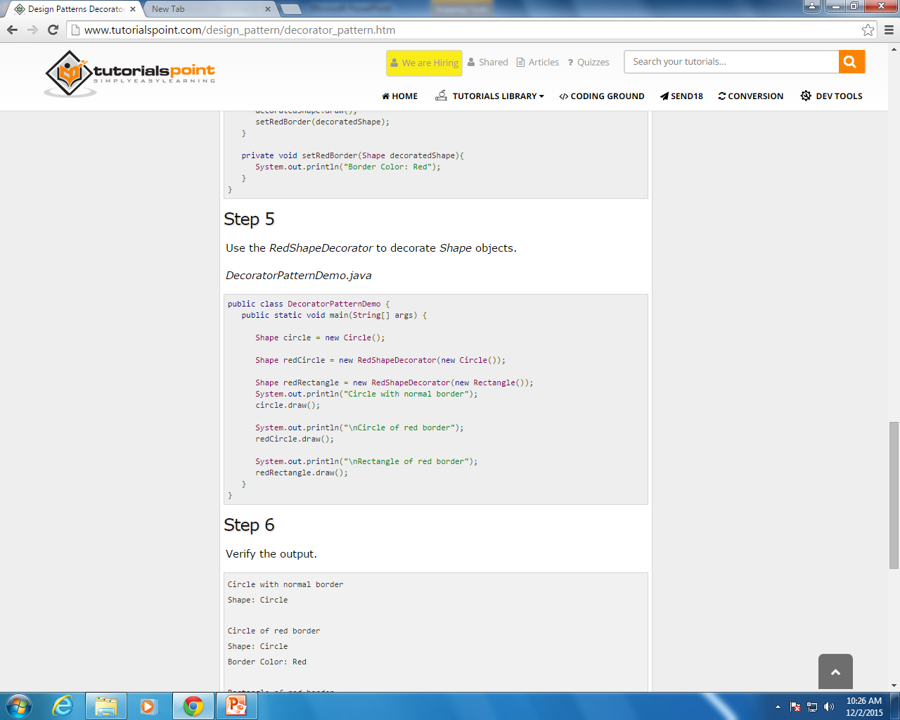
Decorator Pattern UML Class Diagram
Step 5
Use the Decorator Class to decorate Shape objects.

Slide 16
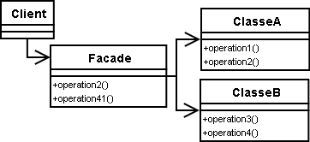
Facade Pattern

Slide 17
Facade Pattern
The Facade Pattern is used when a system is very complex or difficult to understand due to a large number of interdependent classes or unavailable source.
This pattern hides the complexities of the larger system and provides a simpler interface to the client through which the end user can access the system.
This design pattern adds an interface to existing system to hide its complexities. The interface acts as a wrapper class that contains the calls to methods of existing classes that the end user needs to access.

Slide 18
Facade Pattern
The Facade Pattern is typically used when
a simple interface is required to access a complex system,
a system is very complex or difficult to understand,
an entry point is needed to each level of layered software, or
the abstractions and implementations of a subsystem are tightly coupled

Slide 19
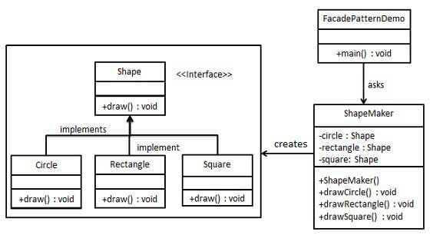
Facade Pattern UML Class Diagram

Slide 20
Facade Pattern UML Class Diagram
Step 1
Create the interface Shape
Step 2
Create concrete classes implementing the same interface.

Slide 21
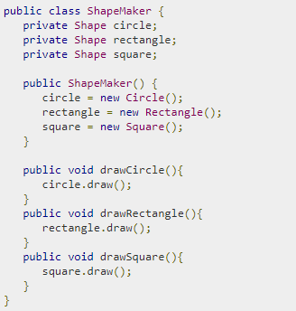
Facade Pattern UML Class Diagram
Step 3
Create the Façade class.
This must include :
Instances of objects that end users need to access through the façade.
Wrapper methods calling all methods that end users need to call for objects in the façade.

Slide 22
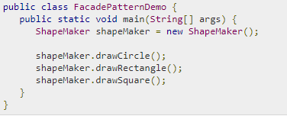
Decorator Pattern UML Class Diagram
Step 4
Use the Façade Class to access the necessary objects and methods

Slide 23
Behavioral Patterns
Deal with the ways in which classes/objects interact and distribute responsibility

Slide 24
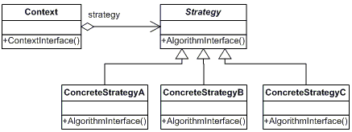
Strategy Pattern

Slide 25
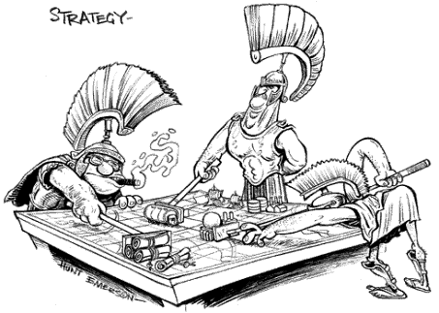
Strategy Pattern
In Strategy Pattern, a class behavior or its algorithm can be changed at run time.
This lets the algorithm vary independently from clients that uses it
It is about choice, which affects outcomes
One behavior and Multiple strategies

Slide 26
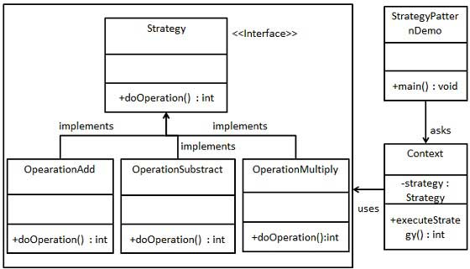
Strategy Pattern
Objects which represent various strategies are created and a context object whose behavior varies according to its strategy
The strategy object changes the executing algorithm of the context object.

Slide 27
Strategy Pattern UML Diagram

Slide 28
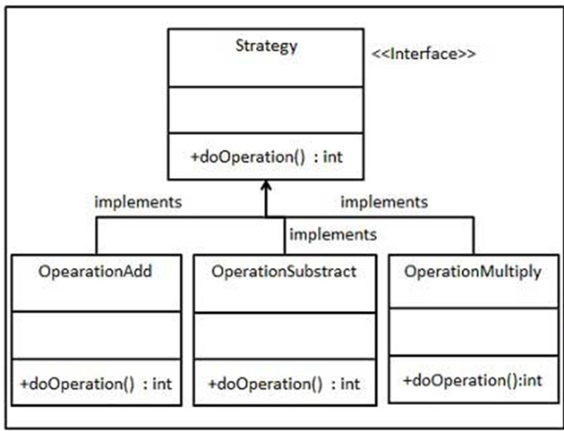
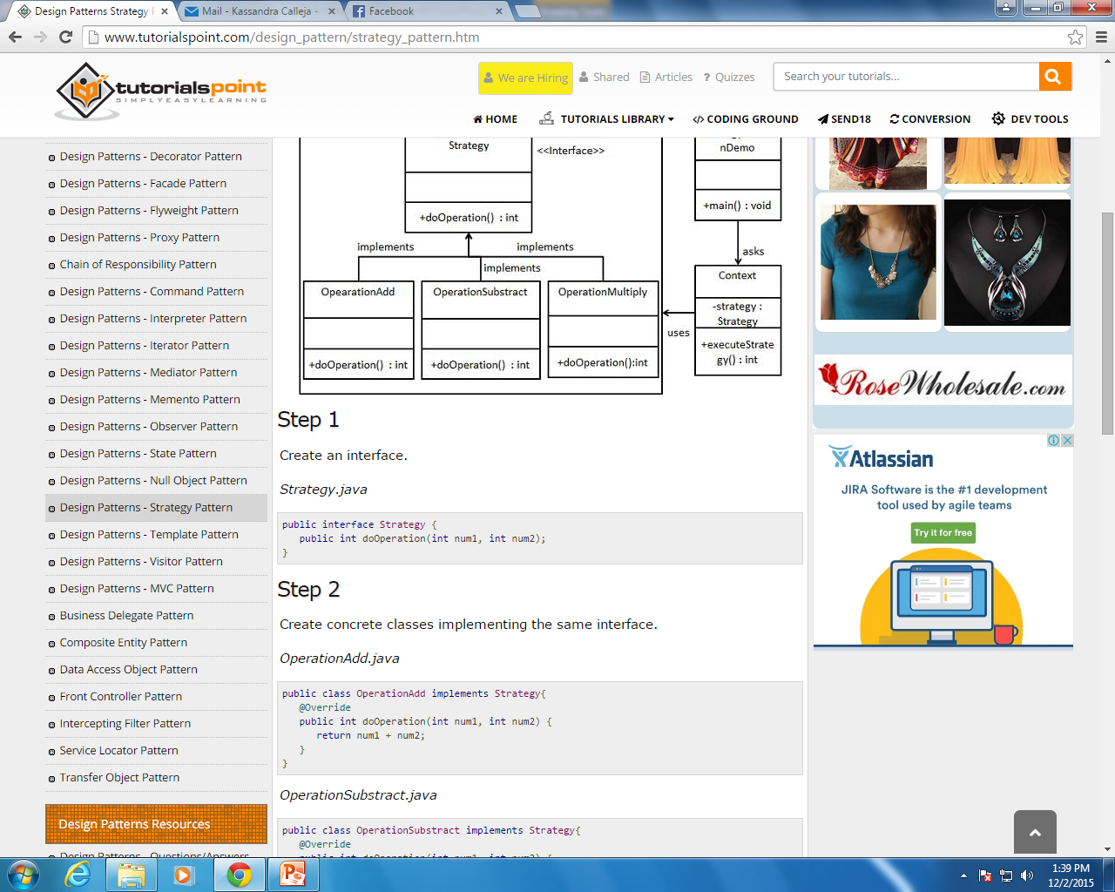
Strategy Pattern UML Diagram
Step 1
Create the strategy interface .
Step 2
Create concrete classes implementing this interface.

Slide 29
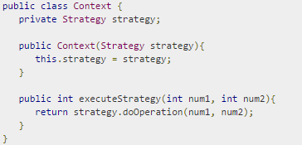
Strategy Pattern UML Diagram
Step 3
Create the Context Class which contains an instance of the Strategy

Slide 30
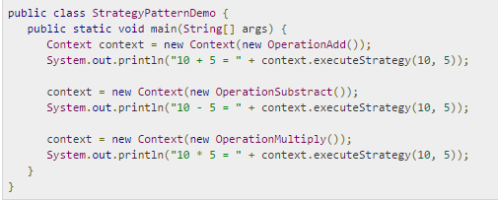
Strategy Pattern UML Diagram
Step 4
Use the Context Class to invoke the necessary strategy.

Slide 31
Reference List
[1] Blackwell, T, 2006, Software engineering, algorithm design and analysis: volume 1, p 3, Goldsmiths College, University of London
[2] Fowler M, 2003, UML Distilled. A Brief Guide to Standard Object Modelling Language, Addison Wesley, 3rd edition

Slide 32

End of Lesson
Any questions?

